Slide 1
Stack Overflow temporal network
This database is about the questions that have been answered in stackoverflow.com within a time interval
This graph contains 286 nodes and 757 edges

Slide 2
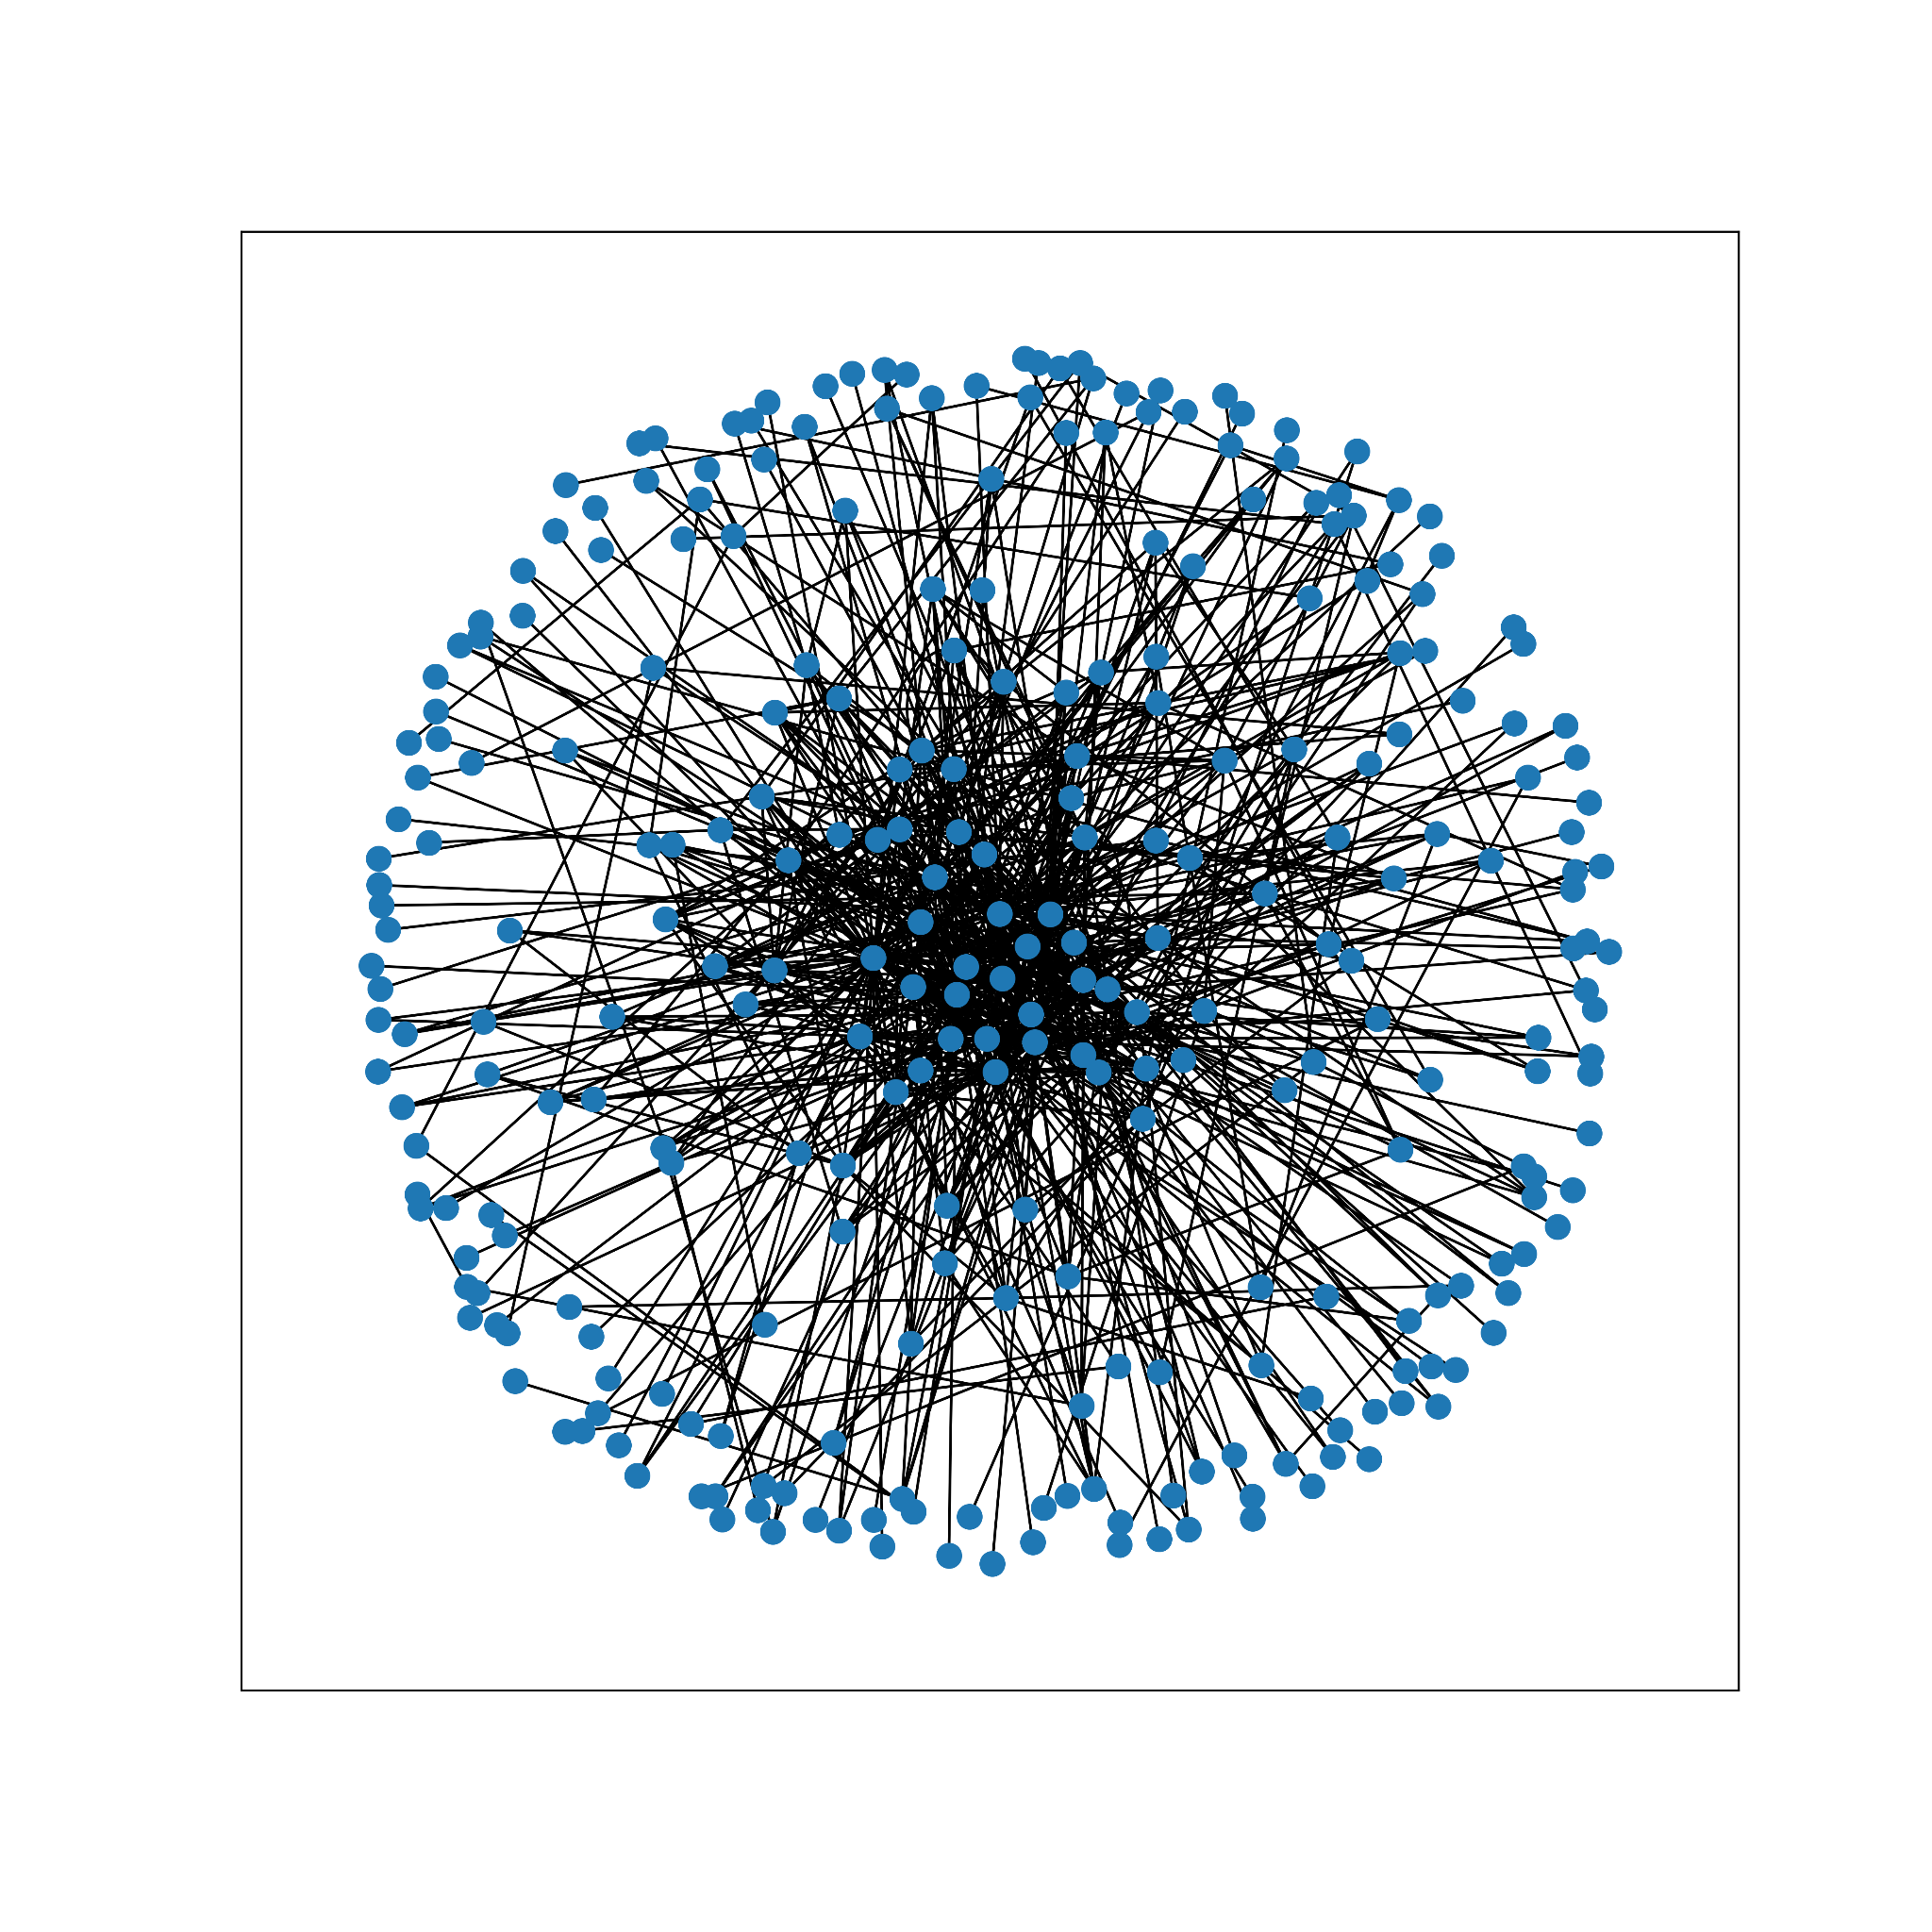
The general shape of the graph using fruchterman reingold layout

Slide 3
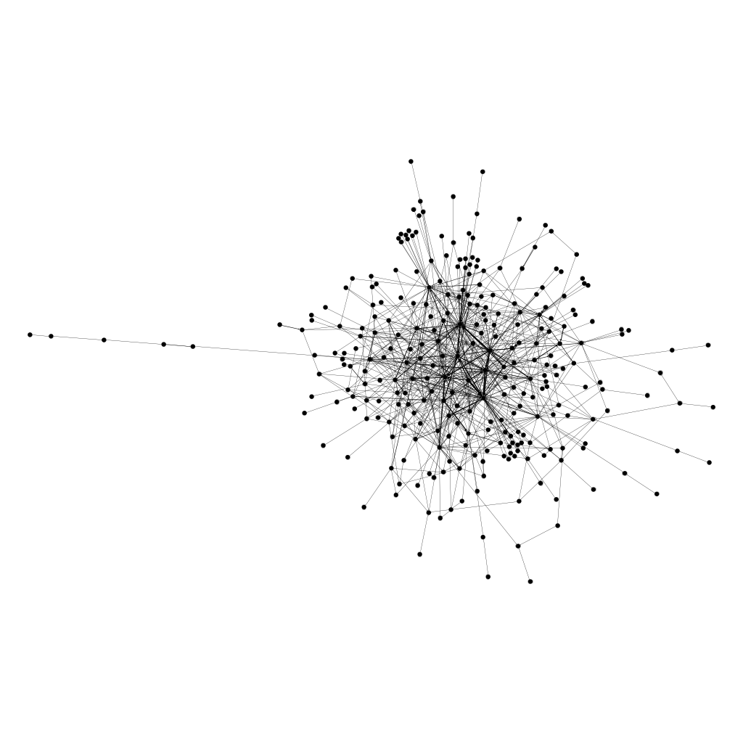
The general shape of the graph using force atlas 2 layout

Slide 4
Degree distribution
Definition: Degree of a node in a network is the number of connections it has to other nodes and the degree distribution is the probability distribution of these degrees over the whole network.
Specially in this network, the max degree of all nodes is considered as the person who answered to questions more than anyone else, let’s call this person John.

Slide 5
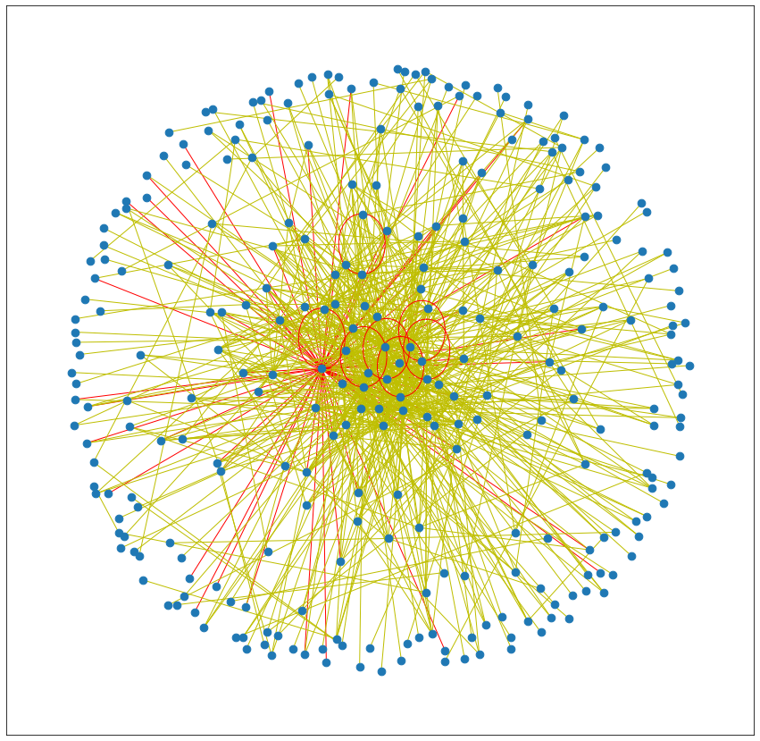
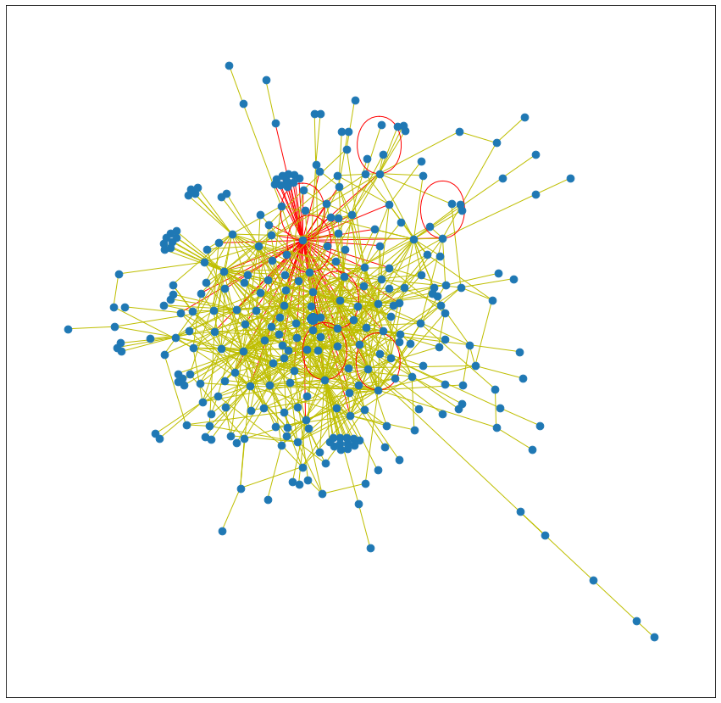
John
John is the person who answered to more questions than anyone else in the community, so if there is any prize for the most interactive person in this network, he is the winner.
John
Other users

Slide 6
Betweenness centrality
General definition: It is a way of detecting the amount of influence a node has over the flow of information in a graph.
Specially in this network, the max betweenness centrality is the node which has the most influence in the network of users. Let’s consider this person as “Erick”.

Slide 7
Top 10 betweenness centralities
User ID | betweenness centrality
1 | 0.2068398002
65 | 0.1771911436
83 | 0.1074144326
290 | 0.09921543962
416 | 0.09483038816
66 | 0.0717797439
350 | 0.06559868294
11 | 0.06212220938
2 | 0.06110291457
143 | 0.05864749536

Slide 8
Erick
Eric was the person with the highest betweenness centrality, in other words it means that Erick answers to more different people than anyone else.
(More people, not essentially more questions)

Slide 9
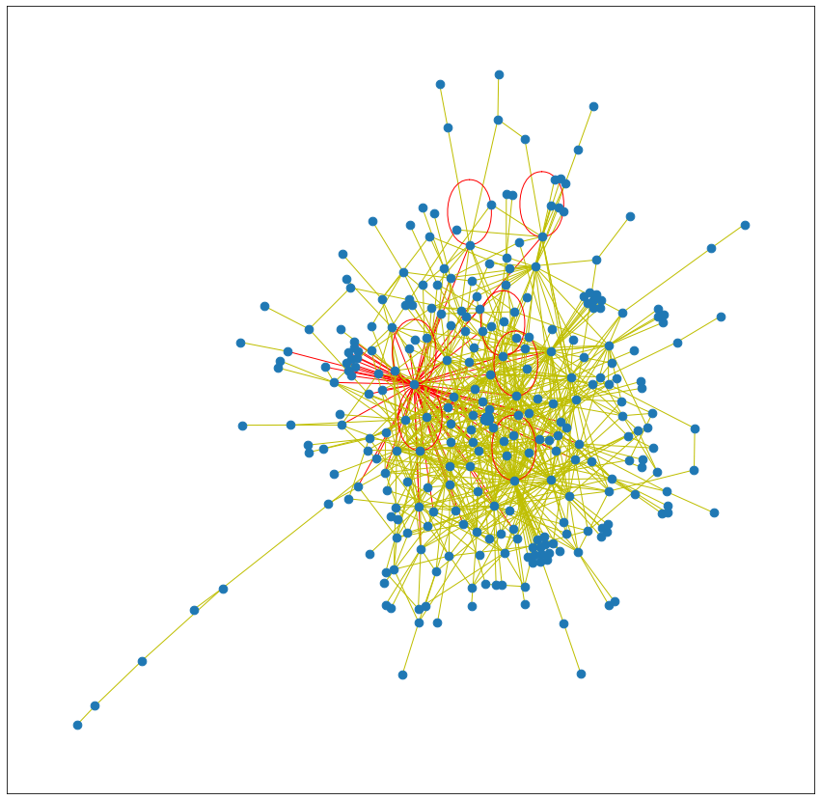
This is the coloring of the edges that Erick answered
He has answered to 63 users within 21 days which is 8.6% of total users, it means that he is one of the main characters in the community
Erick
Other users

Slide 10
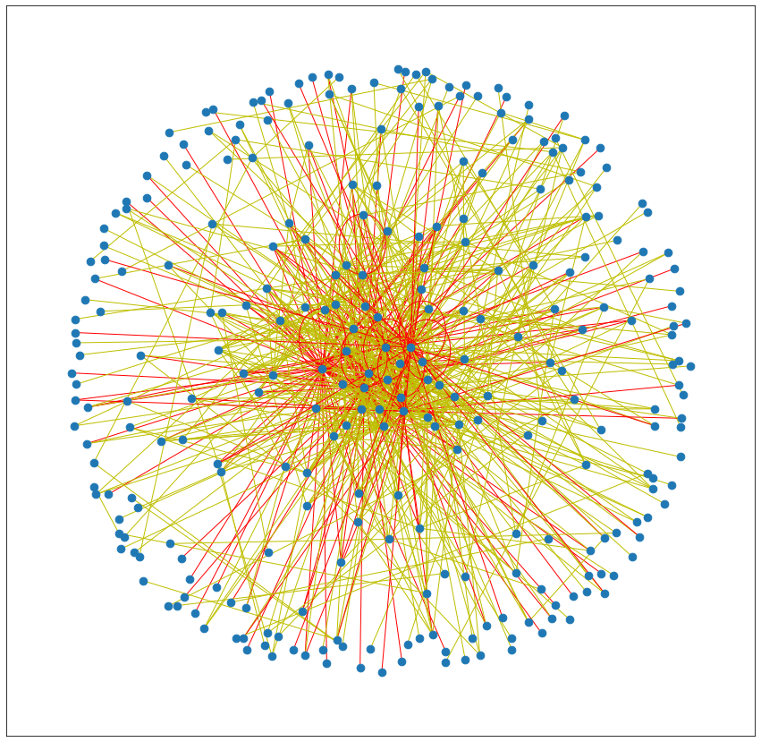
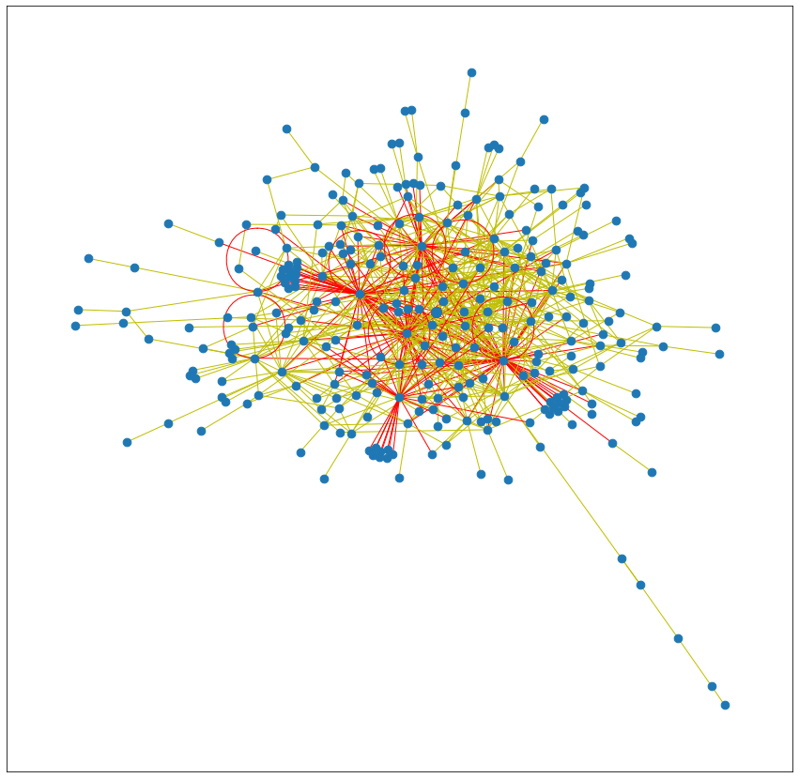
Interesting fact
1. Top five users in the community answer to 32.7% of the users in the community, it also means that they’re answering to 32.7% of the questions asked in the community which is also a large number
Top 5
Other users

Slide 11
Closeness centrality
General definition: A measure of the average shortest distance from each vertex to each other vertex.
Specially in this case, closeness centrality shows the broadness of a user.

Slide 12
Top 10 closeness centralities
User ID | Closeness centrality
1 | 0.4760414783
65 | 0.4672110293
290 | 0.4664244787
83 | 0.4512314989
2 | 0.4425816939
66 | 0.4356228622
382 | 0.4322248679
11 | 0.4172532234
317 | 0.4147547011
416 | 0.4147547011

Slide 13
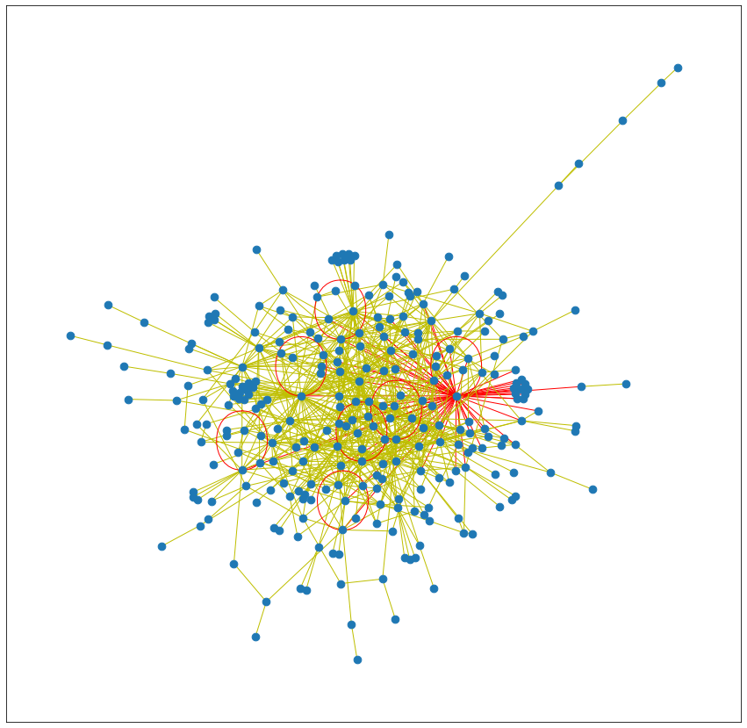
Jack
By finding the maximum value of closeness centrality we can find the person who has the broadest knowledge in the community, let’s call this user Jack
As it shows, Jack with closeness centrality ≈ 0.4760 has the broadest knowledge in the community in other words, if you ask him skin-deep questions in almost any field he has most probably an answer for it

Slide 14
Knowledge deepness
For finding the person who has the deepest knowledge in the community, we should find the person who has the most answers in each community and for this purpose, we can use community_generator function in networkx.

Slide 15
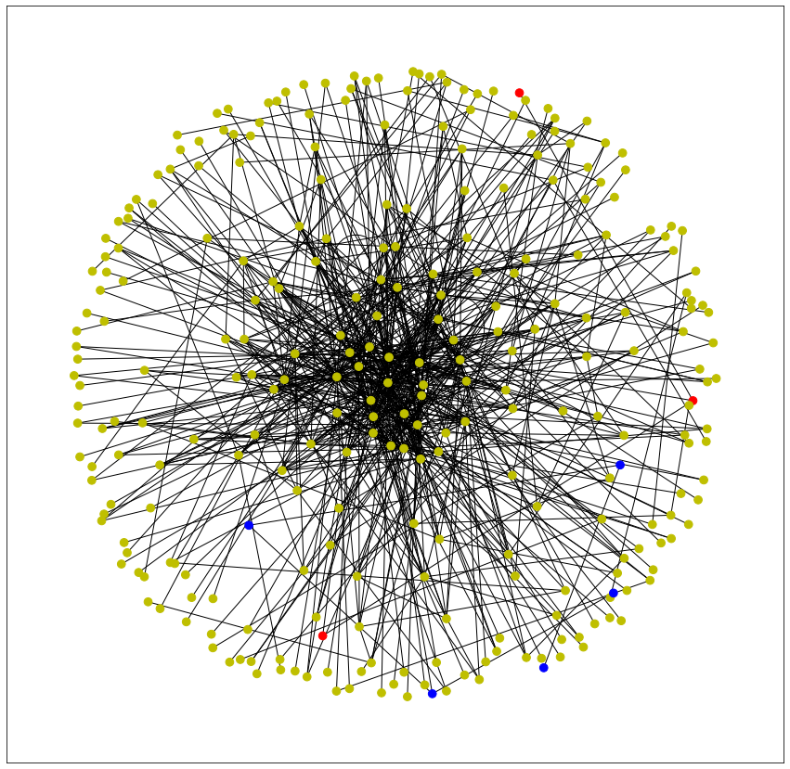
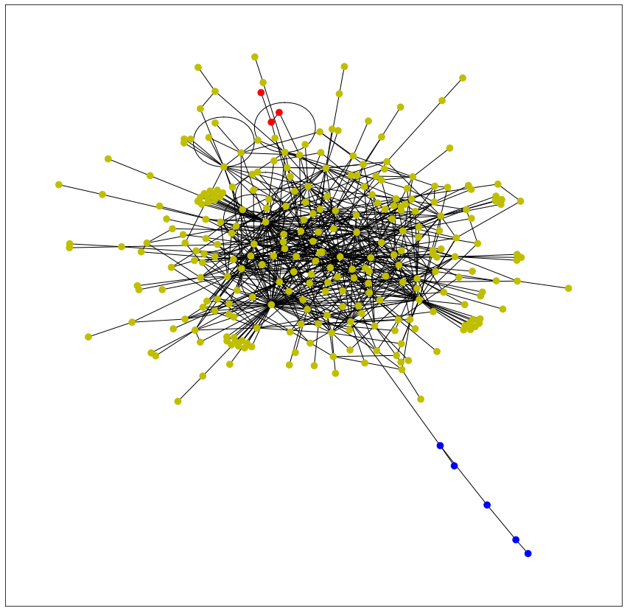
The user with maximum knowledge in each community is user (1, 273, 537) with number of edges (63, 3, 3)

Slide 16
Interesting fact about Erick, John and Jack
1. By considering the ID of John, Erick and jack we can easily find out that they are actually the same person, it means that the person who answered to more questions, also answered to more users, having the broadest and also the deepest knowledge in the community
2. The value of degree distribution and betweenness centrality is the same for this person, which it means he has answered to a user which had not answered previously.

Slide 17
Proof of previous facts
For proving these facts, we can use eigenvector centrality to show who is the most valuable user in the community

Slide 18
Eigenvector centrality
In general, eigenvector centrality is an algorithm that measures the transitive influence of nodes.
And in this particular case it shows the most valuable user of the network, in two different aspects:
Answering to many questions of low level users
Answering to small amount of high level users
And as we would expect, again Erick, john or whoever you may want to call him, is the most valuable user in the network by the eigenvector centrality ≈ 0.3200

Slide 19
Top 5 most valuable users in the network
The user 1 with eigenvector_centrality = 0.32007968900077294 is the most valuable user in the community
The user 65 with eigenvector_centrality = 0.3365129361884228 is the 2nd valuable user in the community
The user 83 with eigenvector_centrality = 0.32195835022918234 is the 3rd valuable user in the community
The user 290 with eigenvector_centrality = 0.3495043816115184 is the 4th valuable user in the community
The user 2 with eigenvector_centrality = 0.28544139133379887 is the 5th valuable user in the community

Slide 20
Growth of network
For this finding that how often a question is answered in the community, it’s sufficient to get the difference between each time interval and finally get the average. Every 34 minutes, an answer is submitted.
For this finding that how often a new user submits an answer, it’s sufficient to get the time interval of new users that submit an answer and then find the average. Every 2.345 hour, a new user submits an answer.

Slide 21
The competition between users
The first most valuable user in the community is user_id = 1 which is the most valuable person in the community from the beginning till the end.
So in this case we consider who is the second most valuable user in the community in time interval of 21 days

Slide 22
List of most valuable user in every day
The user 16 with eigenvector_centrality = 0.6738873379214476 is the most valuable user in the community
The user 3 with eigenvector_centrality = 0.49865522402294005 is the most valuable user in the community
The user 65 with eigenvector_centrality = 0.41559643999475215 is the most valuable user in the community
The user 66 with eigenvector_centrality = 0.4644025347515084 is the most valuable user in the community
The user 66 with eigenvector_centrality = 0.43272432437464453 is the most valuable user in the community
The user 65 with eigenvector_centrality = 0.4053883146911855 is the most valuable user in the community
The user 65 with eigenvector_centrality = 0.4011362739657006 is the most valuable user in the community
The user 65 with eigenvector_centrality = 0.3971516927591615 is the most valuable user in the community
The user 65 with eigenvector_centrality = 0.3796685508872488 is the most valuable user in the community
The user 83 with eigenvector_centrality = 0.3632247033677933 is the most valuable user in the community
The user 83 with eigenvector_centrality = 0.37537330301861455 is the most valuable user in the community
The user 83 with eigenvector_centrality = 0.3712986158878067 is the most valuable user in the community
The user 83 with eigenvector_centrality = 0.3915773970445797 is the most valuable user in the community
The user 83 with eigenvector_centrality = 0.40106671131355776 is the most valuable user in the community
The user 83 with eigenvector_centrality = 0.4000692197982511 is the most valuable user in the community
The user 83 with eigenvector_centrality = 0.392602680496403 is the most valuable user in the community
The user 83 with eigenvector_centrality = 0.38760153299722533 is the most valuable user in the community
The user 83 with eigenvector_centrality = 0.37876105059659176 is the most valuable user in the community
The user 83 with eigenvector_centrality = 0.371198590610463 is the most valuable user in the community
The user 83 with eigenvector_centrality = 0.3560366267722958 is the most valuable user in the community
The user 83 with eigenvector_centrality = 0.35443185853738335 is the most valuable user in the community

Slide 23
User 83
As it’s clear, the competition is between 4 users for the second place of most valuable user, and user 83 was the most valuable user for 14 days in a row.

Slide 24
Addiction to stack overflow
user 16 is the 2nd most valuable user
user 3 is the 2nd most valuable user
user 65 is the 2nd most valuable user
user 66 is the 2nd most valuable user
user 66 is the 2nd most valuable user
user 65 is the 2nd most valuable user
user 65 is the 2nd most valuable user
user 65 is the 2nd most valuable user
user 65 is the 2nd most valuable user
user 83 is the 2nd most valuable user
user 83 is the 2nd most valuable user
user 83 is the 2nd most valuable user
user 83 is the 2nd most valuable user
user 83 is the 2nd most valuable user
user 83 is the 2nd most valuable user
user 83 is the 2nd most valuable user
user 83 is the 2nd most valuable user
user 83 is the 2nd most valuable user
user 83 is the 2nd most valuable user
user 83 is the 2nd most valuable user
user 83 is the 2nd most valuable user
user 2 is the 3rd most valuable user
user 2 is the 3rd most valuable user
user 66 is the 3rd most valuable user
user 65 is the 3rd most valuable user
user 65 is the 3rd most valuable user
user 66 is the 3rd most valuable user
user 66 is the 3rd most valuable user
user 83 is the 3rd most valuable user
user 83 is the 3rd most valuable user
user 66 is the 3rd most valuable user
user 66 is the 3rd most valuable user
user 65 is the 3rd most valuable user
user 66 is the 3rd most valuable user
user 65 is the 3rd most valuable user
user 66 is the 3rd most valuable user
user 66 is the 3rd most valuable user
user 66 is the 3rd most valuable user
user 65 is the 3rd most valuable user
user 65 is the 3rd most valuable user
user 65 is the 3rd most valuable user
user 65 is the 3rd most valuable user
user 27 is the 4th most valuable user
user 16 is the 4th most valuable user
user 16 is the 4th most valuable user
user 2 is the 4th most valuable user
user 2 is the 4th most valuable user
user 2 is the 4th most valuable user
user 83 is the 4th most valuable user
user 66 is the 4th most valuable user
user 66 is the 4th most valuable user
user 65 is the 4th most valuable user
user 65 is the 4th most valuable user
user 66 is the 4th most valuable user
user 65 is the 4th most valuable user
user 66 is the 4th most valuable user
user 65 is the 4th most valuable user
user 65 is the 4th most valuable user
user 65 is the 4th most valuable user
user 66 is the 4th most valuable user
user 290 is the 4th most valuable user
user 290 is the 4th most valuable user
user 290 is the 4th most valuable user

Slide 25
If you consider the repetition of the users in top 4 valuable users in the network, it’s easy to see these people are getting addicted to giving answers in the community.

Slide 26
Useful links
Here is the link to the GitHub repo of the project.
Here is the link for used dataset.

Slide 27
Thank you for your attention

